Slide 1

Analysis On Indore_Restaurants (Clustering & Sentiment Analysis)
Devi Ahilya Vishwavidyalaya, Indore
School of statistics
Jan-May2023
Guided By:
Dr. Snigdha Banerjee
Head of Department
School of Statistics
Sumitted By:
Shubhangani Tiwari
M.Sc 4th Sem

Slide 2

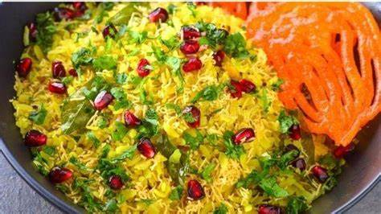
Introduction
The commercial capital of Madhya Pradesh, Indore has another name as the “city of foodies”. This name has been given to Indore because of its Flavours, it’s variety of chats and the wide range of street foods.
Indore city prides itself on its food. People from all across the country have settled up here, particularly from Rajasthan, Maharashtra and UP. The number of restaurants in Indore are increasing day by day. Currently around 3900 restaurants in Indore are listed on Zomato. With each day new restaurants opening the industry hasn't been saturated yet and the demand is increasing day by day !
Despite increasing demand, it however has become difficult for new restaurants to compete with established restaurants. With such an overwhelming demand of restaurants it has therefore become important to study the demography of a location.
The key issues that continue to pose a challenge to them include high real estate costs, rising food costs, shortage of quality manpower, fragmented supply chain and over-licensing. This project also will help people in choosing the restaurant based on several factors.
This project will help new restaurants in deciding their theme, menus, cuisine, cost, locality, etc for a particular location.
“Just so that you have a good meal the next time you step out”

Slide 3
Objective
The basic objective of analyzing the Zomato dataset is to gather insights about the factors affecting the establishment of different types of restaurant at different places in Indore.
This project aims at exploring demography, consumer behaviour, and food culture of the city.
This project is carried out in a sequence of steps,
The first of which consists of an exploratory analysis, where the objective is to know the behaviour of the variables and to analyze attributes.
Second part, which is performing the “Sentiment Analysis” on the reviews given by the customers to the different restaurants.
Third part is to perform Principal Component Analysis to find out the important features for clustering.
Fourth step is to perform clustering.

Slide 4
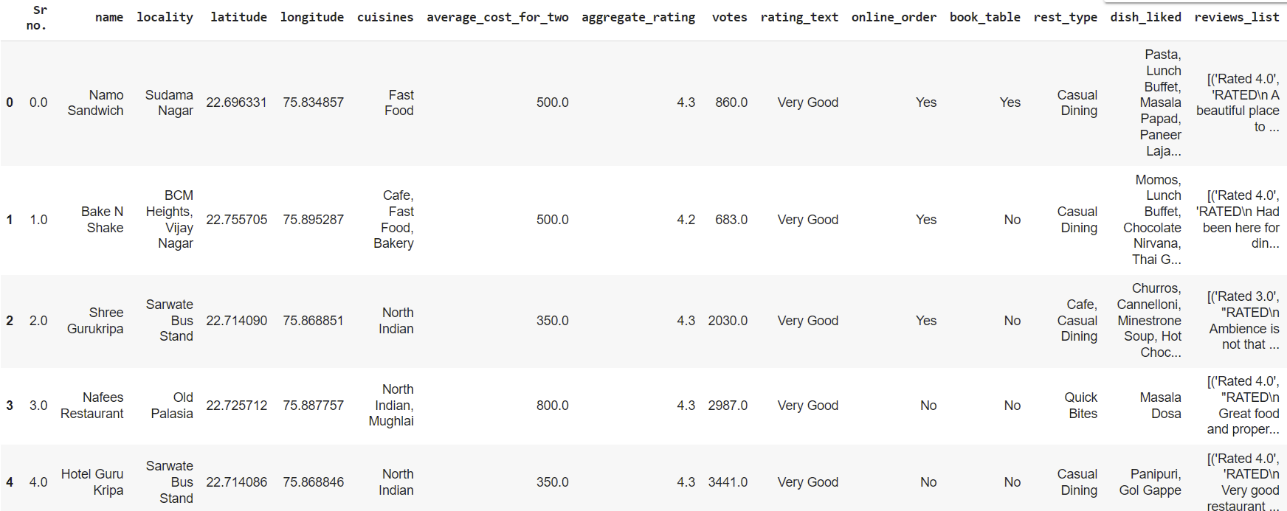
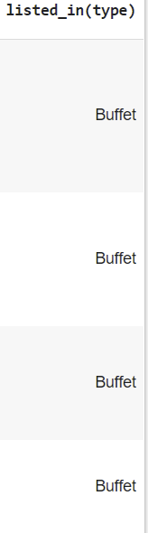
Dataset Description
Dataset collected from Zomato consists of following features:
Data Source:
https://www.zomato.com/india

Slide 5
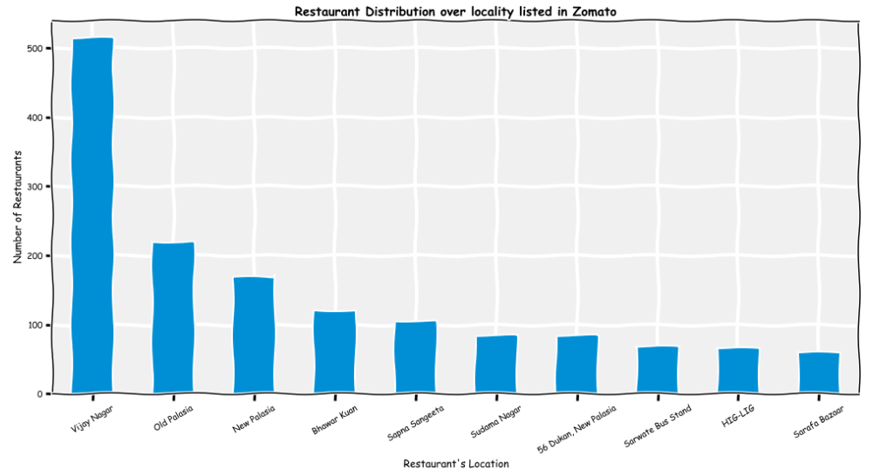
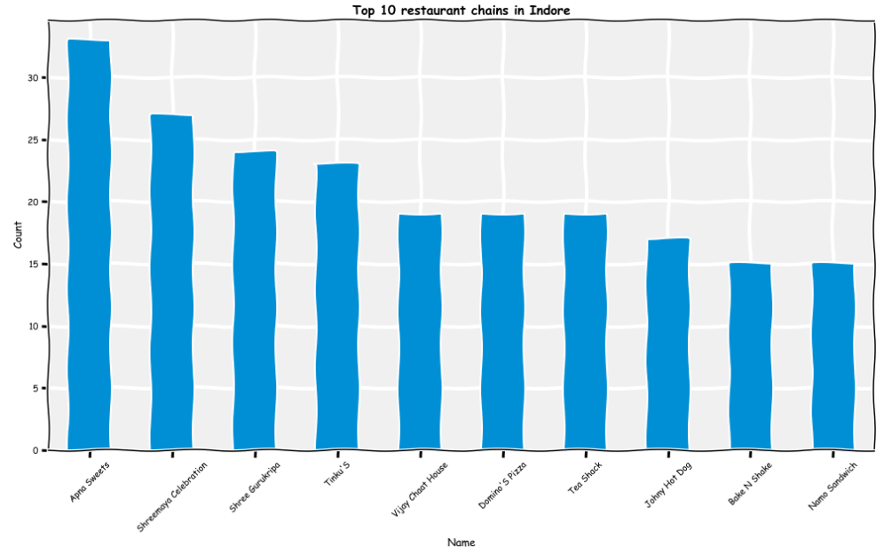
Restaurant Distribution over locality
Part1: Visualization
Top 10 restaurant chain in Indore
Some of the top restaurant chains that have decent ratings and votes are Apna Sweets, Shreemaya Celebration, Shree Gurukripa, etc.
Vijay Nagar has the highest number of restaurants, followed by Old Palasia and New Palasia

Slide 6
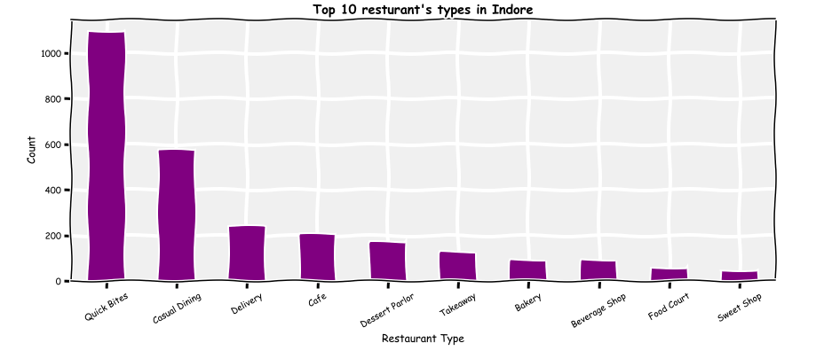
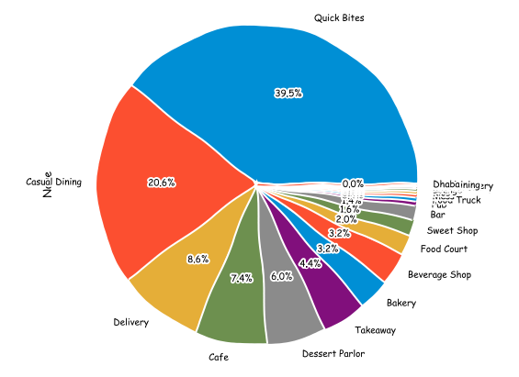
Top restaurants type in Indore
Quick Bites is the most common restaurant type in Indore, followed by Casual Dining.

Slide 7
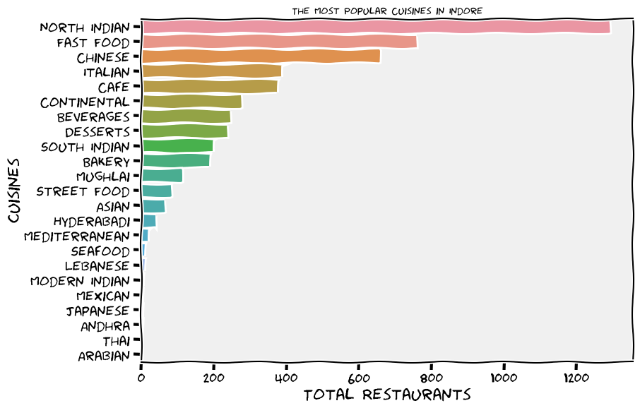
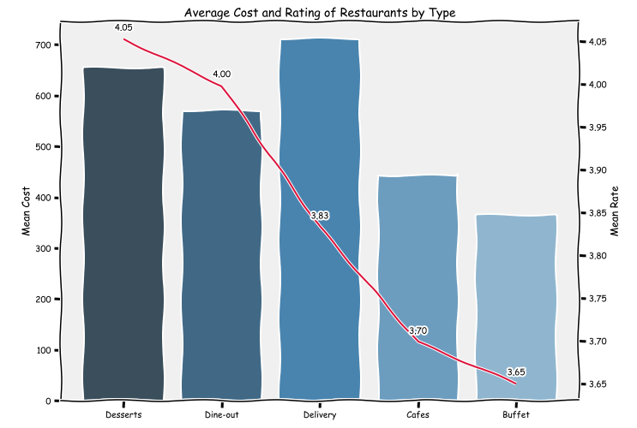
chart shows that North indian is at the top of cuisines provided in Indore, followed by Fast Food and Chinese.
Top 20 Cuisines in Indore
Average Cost and Rating for each restaurant type
Desserts have high mean cost, but also highest rating, followed by dine-out.
So, generally high cost restaurants tend to have higher ratings also.

Slide 8
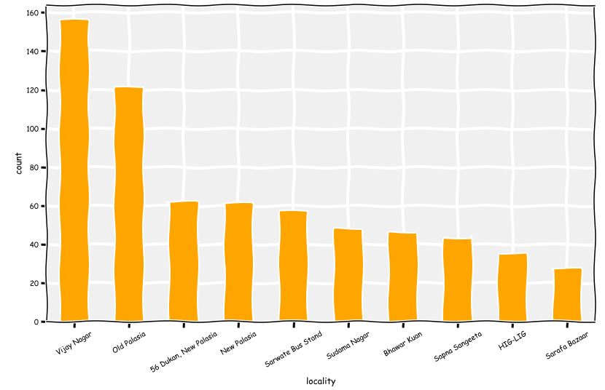
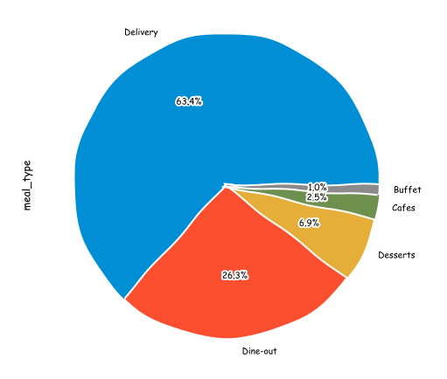
Where can one find the best restaurants in Indore?
Top restaurant service types in Indore
Delivery meal_types is highest(63.4) in Indore, followed by Dine-out(26.3%) and Desserts(6.9%).
Vijay Nagar is again at the top of the list, followed by Old Palasia and New Palasia

Slide 9
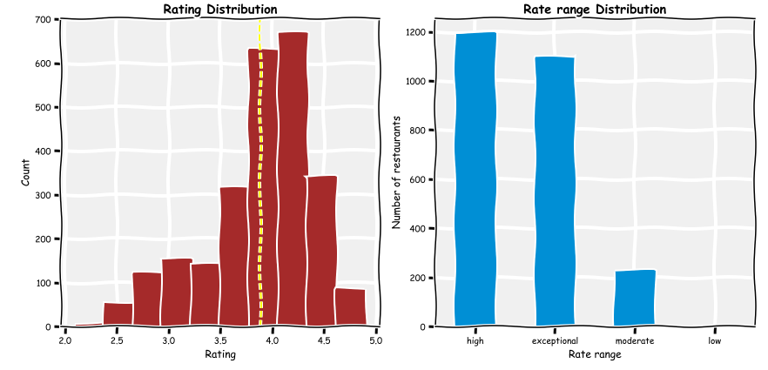
Distribution of aggregate_rating
As we notice here that it's almost normal distribution with average at 3.9
The majority of restaurants rated between 3.5 and 4.5 (High range)

Slide 10
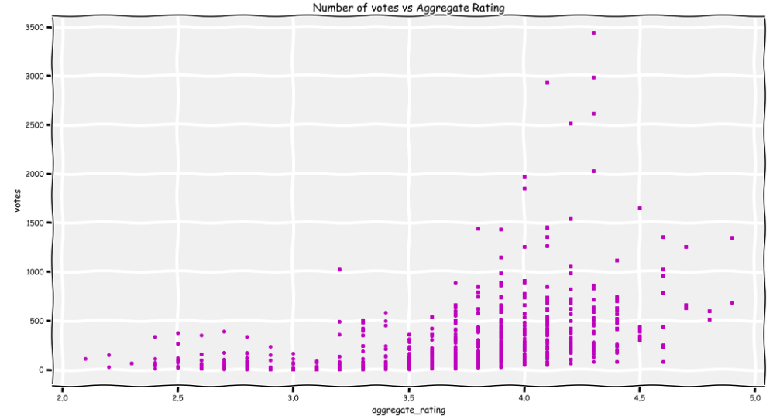
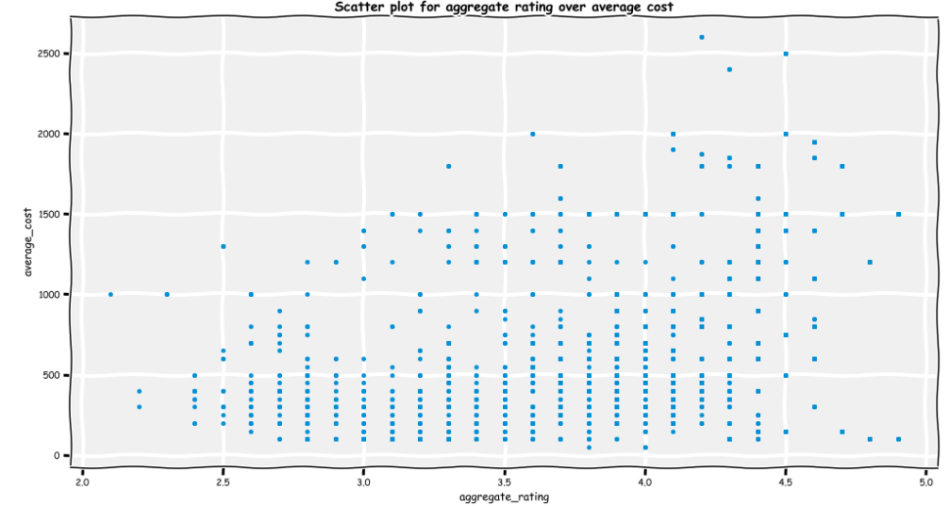
Relation of ratings and Votes
Scatter plot for aggregate rating over average cost
Aggregate_rating between 3.5 and 4.5 has highest number of votes.
Higher cost restaurants ( > 1500) tends to have higher ratings ( > 3.5).

Slide 11
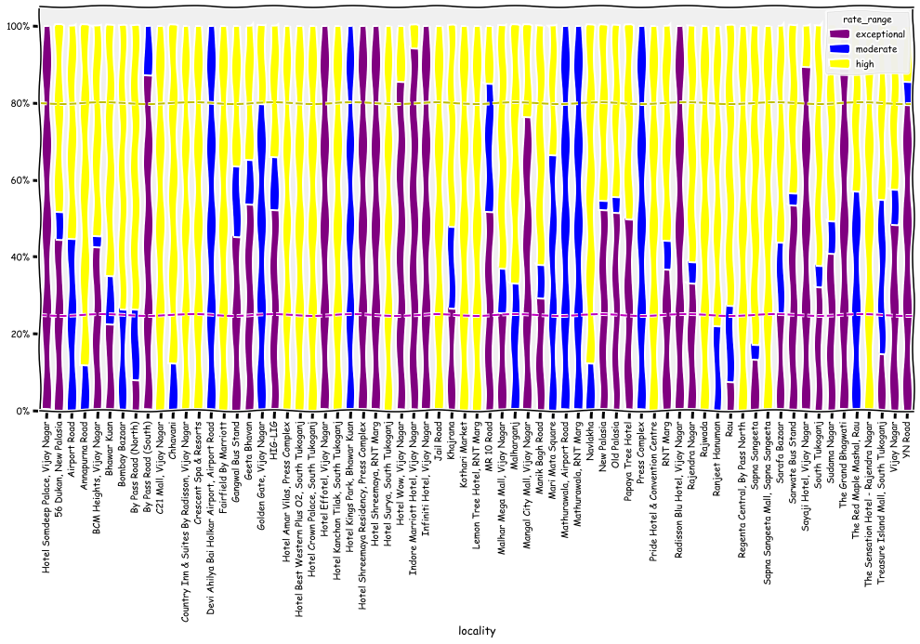
Aggregate Rating per Locality
Vijay Nagar and RNT Marg has highest number of exceptional (4-5) rated restaurants.
Devi Ahilyabai Holkar Airport, RNT Marg, Bhawar Kaun and Press Complex has highest number of high (3-4) rated type restaurant in Indore.
Vijay Nagar, Jail Road, South Tukaganj, Kothari Market, Press Complex, Rajwada, Sapna Sangeeta Mall and Rajender Nagar has highest number of moderate (2-3) rated type of restaurants.

Slide 12
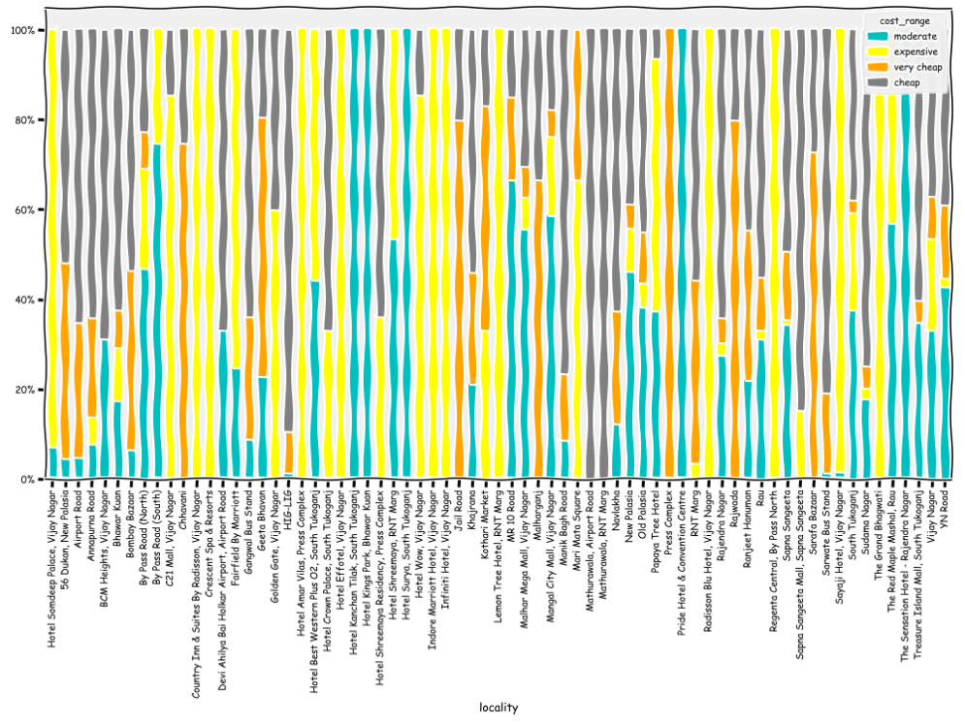
What is the relation between cost and neighbourhood?
So crowded as we have 69 locations, but you can notice the following:
Vijay Nagar, RNT Marg, Crescent Spa & Resorts, Kothari Market, Regenta Central and Mari Mata Square has some of the expensive (1000-3000) restaurants.
South Tukaganj, Bhawar Kuan, By Pass Road (South), The Red Maple Marshal Road and Rajender Nagar has some of the moderately (500-1000) priced restaurants.
HIG-LIG, Mathurawala, Sudama Nagar and Manik Marg Road has some of the cheapest (100-500) restaurants.
Press Complex, Chhavani, Jail Road, Geeta Bhavan, Rajwada and Sarafa Bazaar has some of the very cheap (0-100) restaurants.
Likely certain locations affected by the level of population hence the costing strategy differs

Slide 13
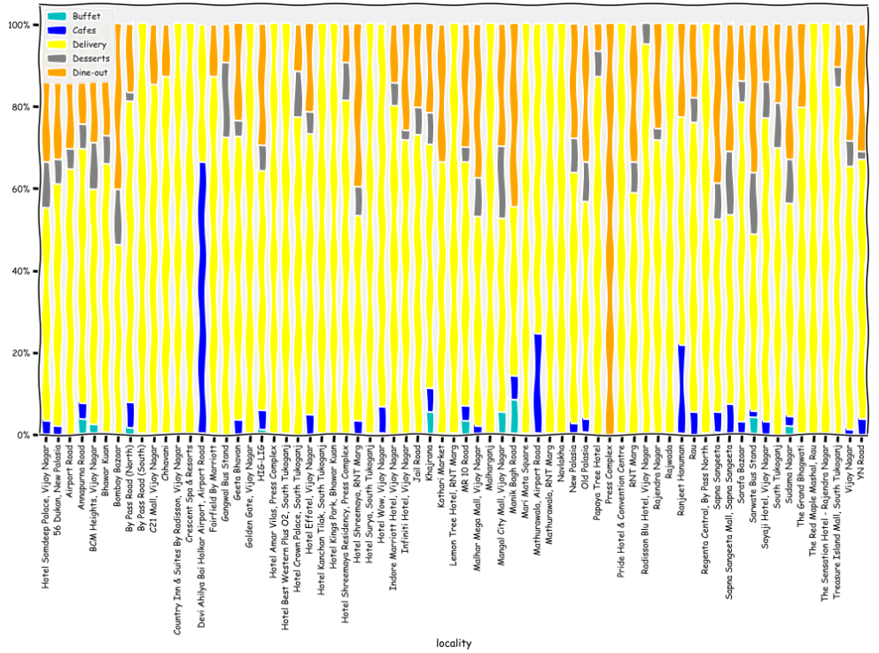
What is the relation between meal_type and locality?
Again here if you go through each color you will get the hint that.
Each locality has preferred meal_type like:
Devi Ahilya Bai Holkar Airport and Mathurawala at Airport Road and Ranjeet Hanuman has higher number of cafes
Red Maple Mashal, RNT Marg, Rajwada, Geeta Bhavan, Navlakha, South Tukaganj has highest number of delivery type restaurant in Indore.
Press Complex, Hotel Shreemaya, Bombay Bazaar, Hotel Somdeep Palace has highest number of dine-out type.
Manik Bhag road, Khajrana, Annapurna road, Sudama Nagar has highest number of Buffer type restaurants.

Slide 14
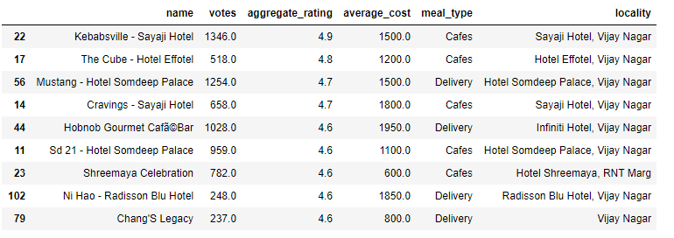
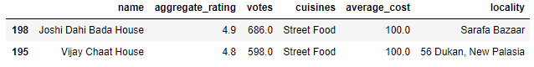
Best rated, most voted restaurants, irrespective of cost
This will be as:
has the high aggregate_rating > 4.5
has the high number of votes as it will more reliable
Best restaurants in Indore ?
Joshi Dahi Bada House and Vijay Chaat House are the best overall restaurant in Indore !!

Slide 15
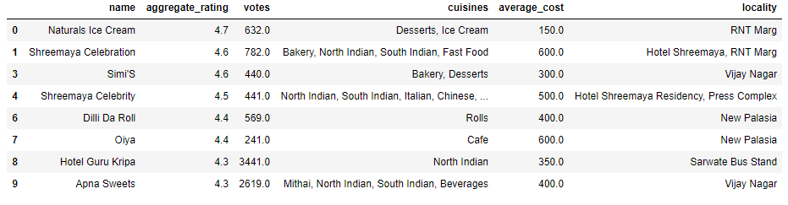
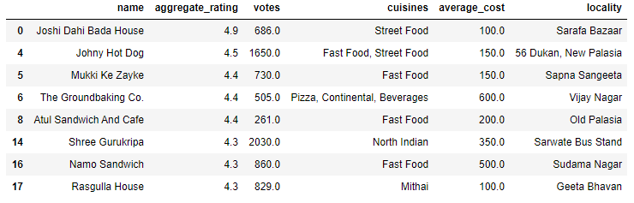
Best dessert parlors in Indore
Best Cafe's in Indore

Slide 16
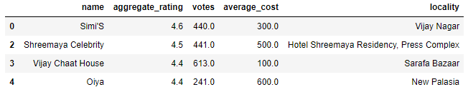
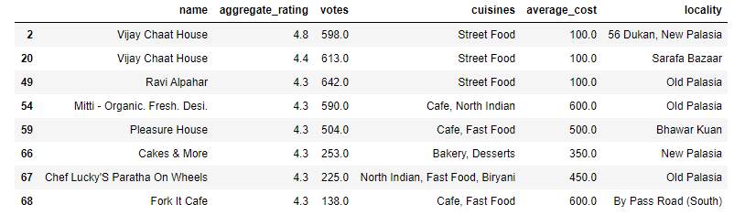
Best bakeries in Indore
Best dine-outs in Indore

Slide 17
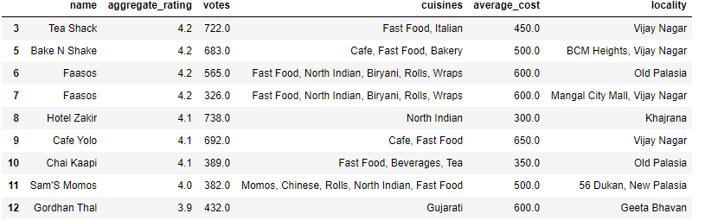
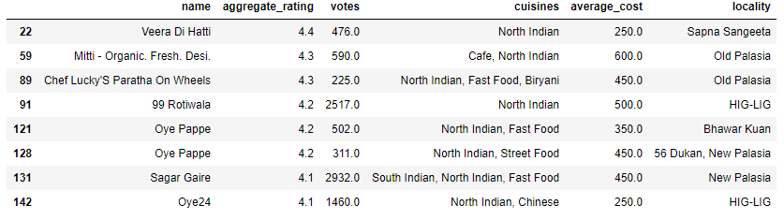
Best Sweet shops in Indore
Best North Indian restaurants in Indore

Slide 18
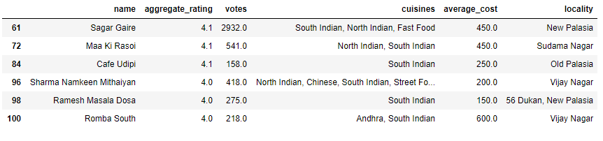
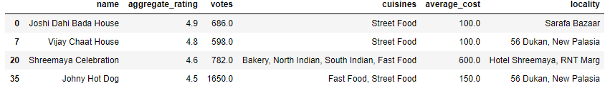
Best South Indian restaurants in Indore
Best Fast- food restaurants in Indore

Slide 19
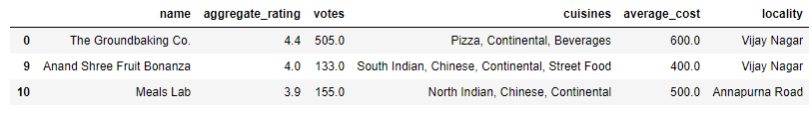
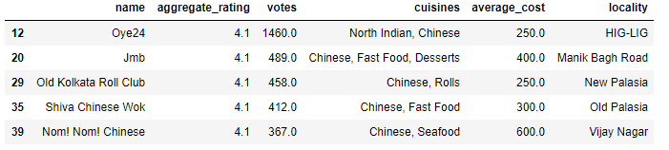
Best Continental restaurants in Indore
Best Chinese restaurants in Indore

Slide 20
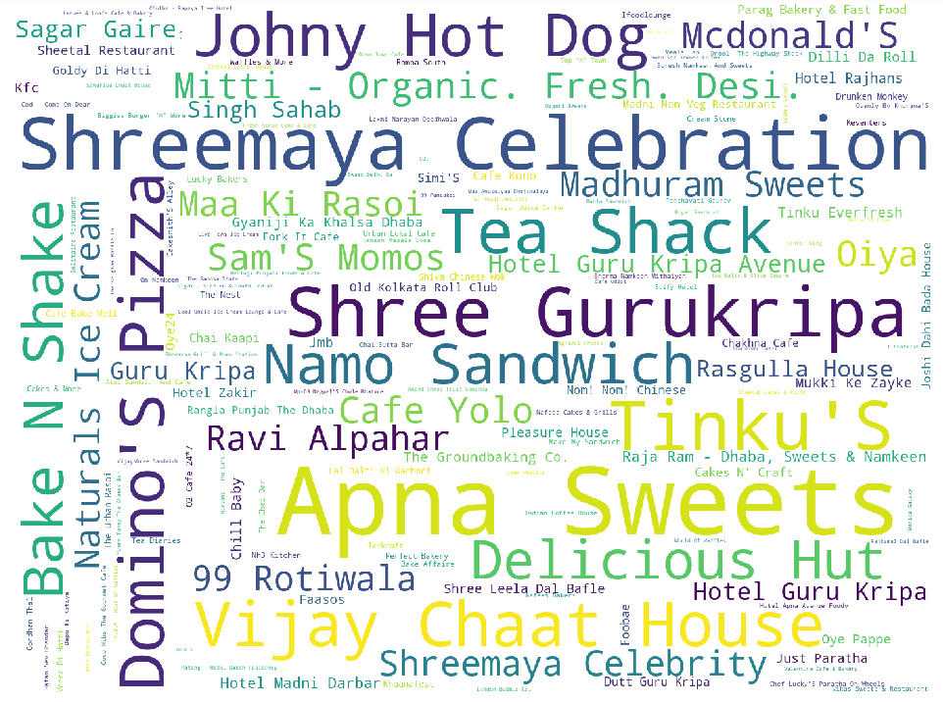
Some of the most famous restaurants in Indore
Word Analysis

Slide 21
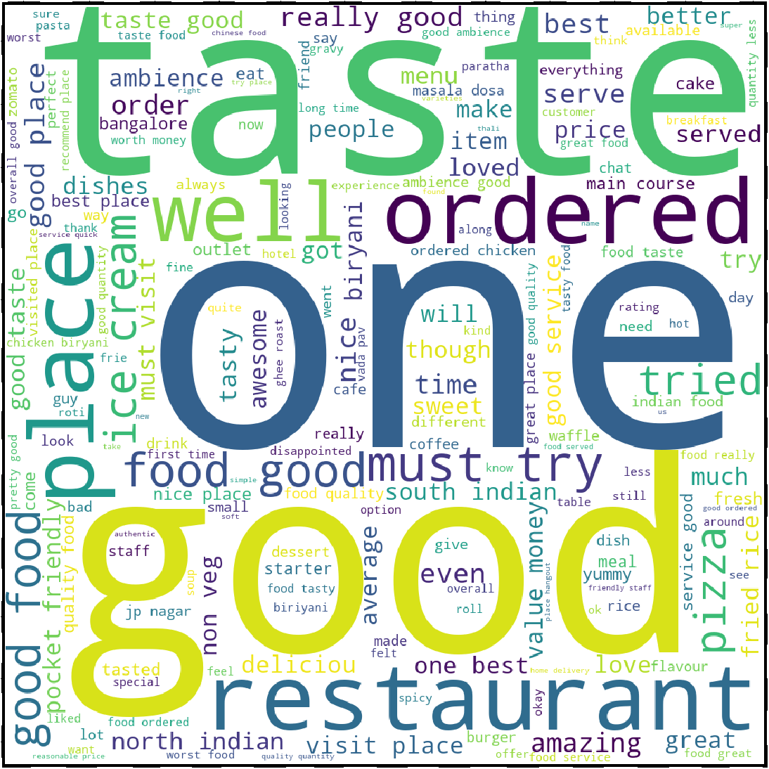
Word Analysis For Customer reviews
Most of the time customers liked the food because good is repeating most in reviews. Also taste, food are next most repeating word.

Slide 22
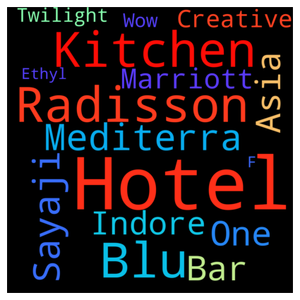
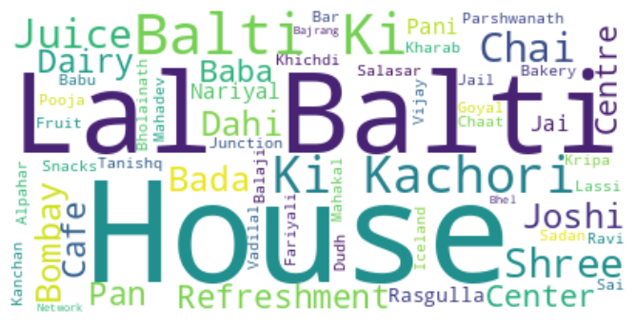
WORDCLOUDS
(Wordcloud show all text and highlight the most frequent words)
EXPENSIVE RESTAURANT
CHEAPEST RESTAURANT
From the above charts ,Radisson,Mediterra, Creative Kitchen etc seems frequently repeating for expensive restaurant, while for cheap restaurants Lal Balti ki Kachori, Joshi Dahi Bada House etc seems frequently repeating. So it can be infer that Hotel and Bars of Indore are expensive while Cafes,Dhabas and street shops are cheaper

Slide 23
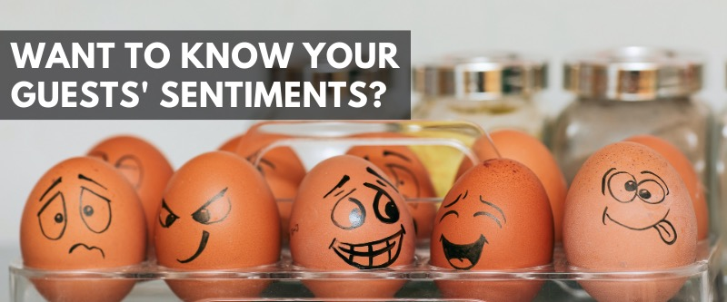
PART2: SENTIMENT ANALYSIS
Sentiment analysis is the process of analyzing digital text to determine if the emotional tone of the message is positive, negative, or neutral.

Slide 24
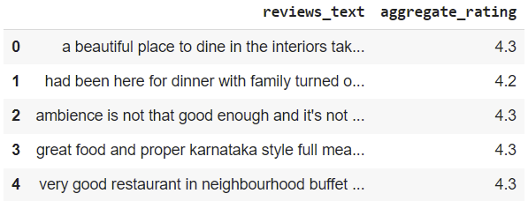
Steps I Followed to Perform Sentiment Analysis are as:
1.Firsty defined a dataframe in which I have selected only two columns which contain ‘Rating’ and ‘Reviews’.
2. The concept of text is very clear for us, we can’t say the same when we talk about computers.
For this reason, before submitting text to analysis, we have to preprocess it.
Textual Data Preprocessing
Lower Casing: Reduced everything to lower case for simplicity.
Punctuation Removal :The punctuation removal process will help to treat each text equally. For example, the word data and data! are treated equally after the process of removal of punctuations.
.

Slide 25
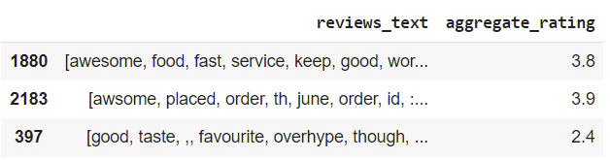
Removing Extra Space: Removing the extra space is good as it doesn’t store extra memory and even we can see the data clearly.
Handling Stopwords: Stopwords are the most commonly occurring words in a text which do not provide any valuable information. stopwords like they, there, this, where, etc are some of the stopwords. NLTK library is a common library that is used to remove stopwords and include approximately 180 stopwords which it removes.
Tokenization: Tokenization is essentially splitting a phrase, sentence, paragraph, or an entire text document into smaller units, such as individual words or terms.
Sampled output after tokenization is as:
Text Normalization: I have used Lemmatization as a text normalization technique since Lemmatization is a systematic way to reduce the words into their lemma by matching them with a language dictionary.

Slide 26
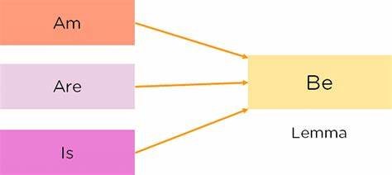
Example of Lemmatization:
Text Vectorization : TF-IDF text vectorization technique is used.
TF-IDF (Term Frequency-Inverse Document Frequency) is a text vectorization technique used to represent text documents as numerical feature vectors. It is commonly used in natural language processing (NLP) and information retrieval tasks.
The TF-IDF technique takes into account the importance of a term (word) in a document relative to a collection of documents. It consists of two main components:
Term Frequency (TF): This component measures the frequency of a term within a document. It is calculated by counting the number of times a term appears in a document. A higher frequency indicates a higher importance of the term within that document.
Inverse Document Frequency (IDF): This component measures the rarity of a term across the entire collection of documents. It is calculated by taking the logarithm of the total number of documents divided by the number of documents that contain the term. The IDF value is higher for terms that appear in fewer documents, indicating their higher importance in distinguishing those documents.
The TF-IDF score for a term in a document is calculated by multiplying its TF value by its IDF value. The resulting TF-IDF scores create a vector representation of the document, where each dimension represents a unique term in the entire collection of documents.

Slide 27
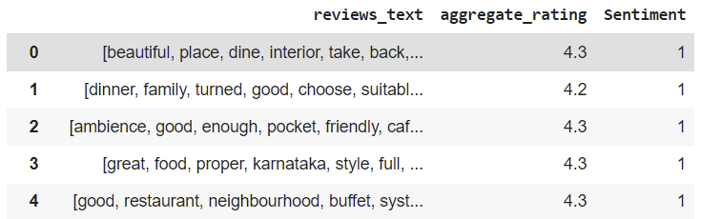
Created a new column named as sentiment extracted by ratings. Sentiment have two categories positive and negative.
If the rating >=3.5 sentiment is positive (positive is denoted by 1)
and If the rating <=3.5 sentiment is negative (denoted by 0).
Now our dataframe looks like:
Our task is to analyze the nature of reviews given by the customers whether review is positive or negative hence our target variable is Sentiment which has two labels 1 which refers to positive reviews and 0 which refers to negative reviews.
Hence our problem becomes the problem of classification with target variable ‘Sentiment’

Slide 28
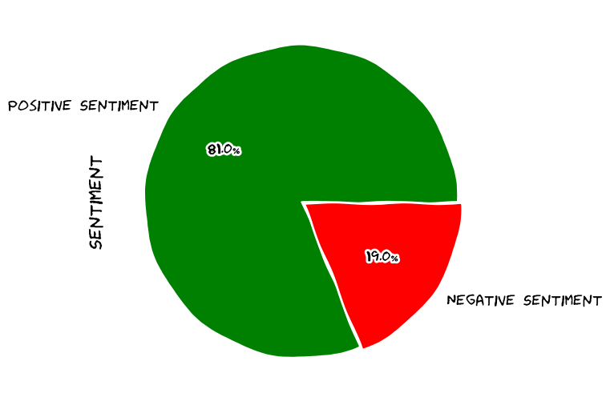
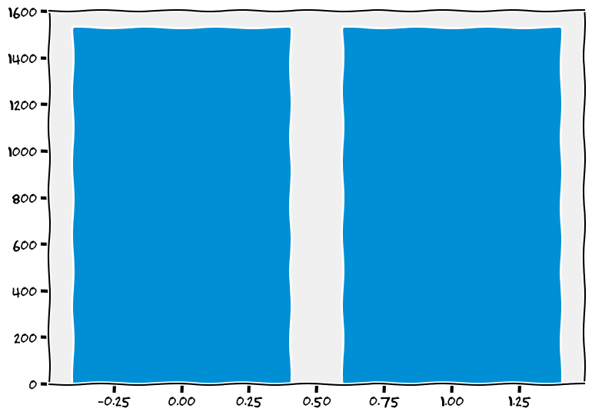
Checking Imbalance in target variable (SENTIMENT)
Pie Chart to see the % of both the labels in target variable:
After applying SMOTE :
Pie Chart shows that target variable is highly imbalanced.
Thus we need to care of this imbalancing in target variable.
Hence our data is completely balanced now.
For handling this imbalance I have used SMOTE technique.
SMOTE refers to Synthetic Minority Oversampling Technique. Which is an algorithm that performs data augmentation by creating synthetic data points based on the original data points

Slide 29
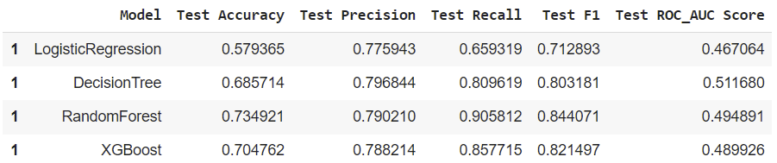
And now we can apply the classification model techniques.
I have used the following models:
Logistic Regression.
Decision Tree.
Random forest
XGBoost
And got the following results:
From the above model metrics, we could consider that Random forest is the best suitable model on this data, followed by XGBoost model and Decision tree.

Slide 30
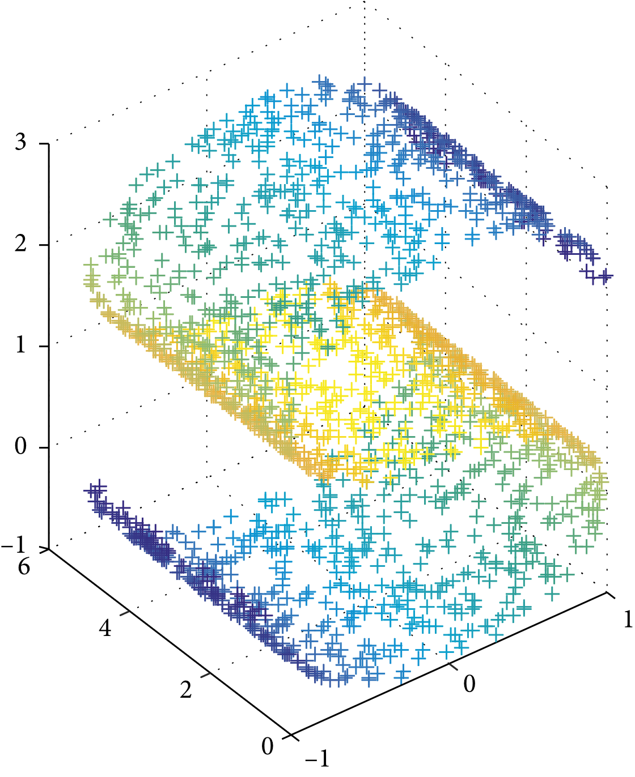
Part 3: Dimensionality Reduction
Dimensionality reduction is a technique used to reduce the number of features in a dataset while retaining as much of the important information as possible. In other words, it is a process of transforming high-dimensional data into a lower-dimensional space that still preserves the essence of the original data.
The various methods used for dimensionality reduction include:
Principal Component Analysis (PCA)
Linear Discriminant Analysis (LDA)
Generalized Discriminant Analysis (GDA)
In this project we will work with Principal Component Analysis.
Principal Component Analysis:
It works on the condition that while the data in a higher dimensional space is mapped to data in a lower dimension space, the variance of the data in the lower dimensional space should be maximum.

Slide 31
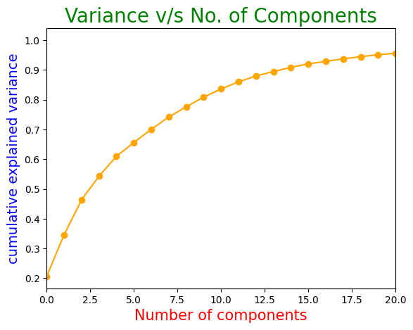
After Categorical Encoding I had 52 features
I have applied PCA on scaled data and plot a graph between no. of components (on X axis) vs cumulate explained variance (on Y axis). Which is as:
From this plot we can clearly see that cumulative variance explained by only 5 features is approx 60% and the remaining variance is explained by the remaining 47 features.
The percentage of variance explained by the 5 features is good enough.

Slide 32
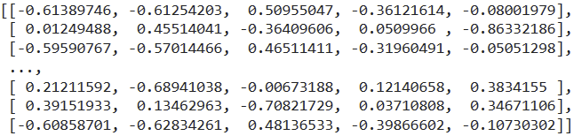
We have taken 5 principal components as our most relevant features in further analysis.
Shape of the data
Before Dimensionality Reduction: (745, 52)
After Dimensionality Reduction: (745, 5)
The value of the silhouette coefﬁcient is between [-1, 1].
PC1 PC2 PC3 PC4 PC5

Slide 33
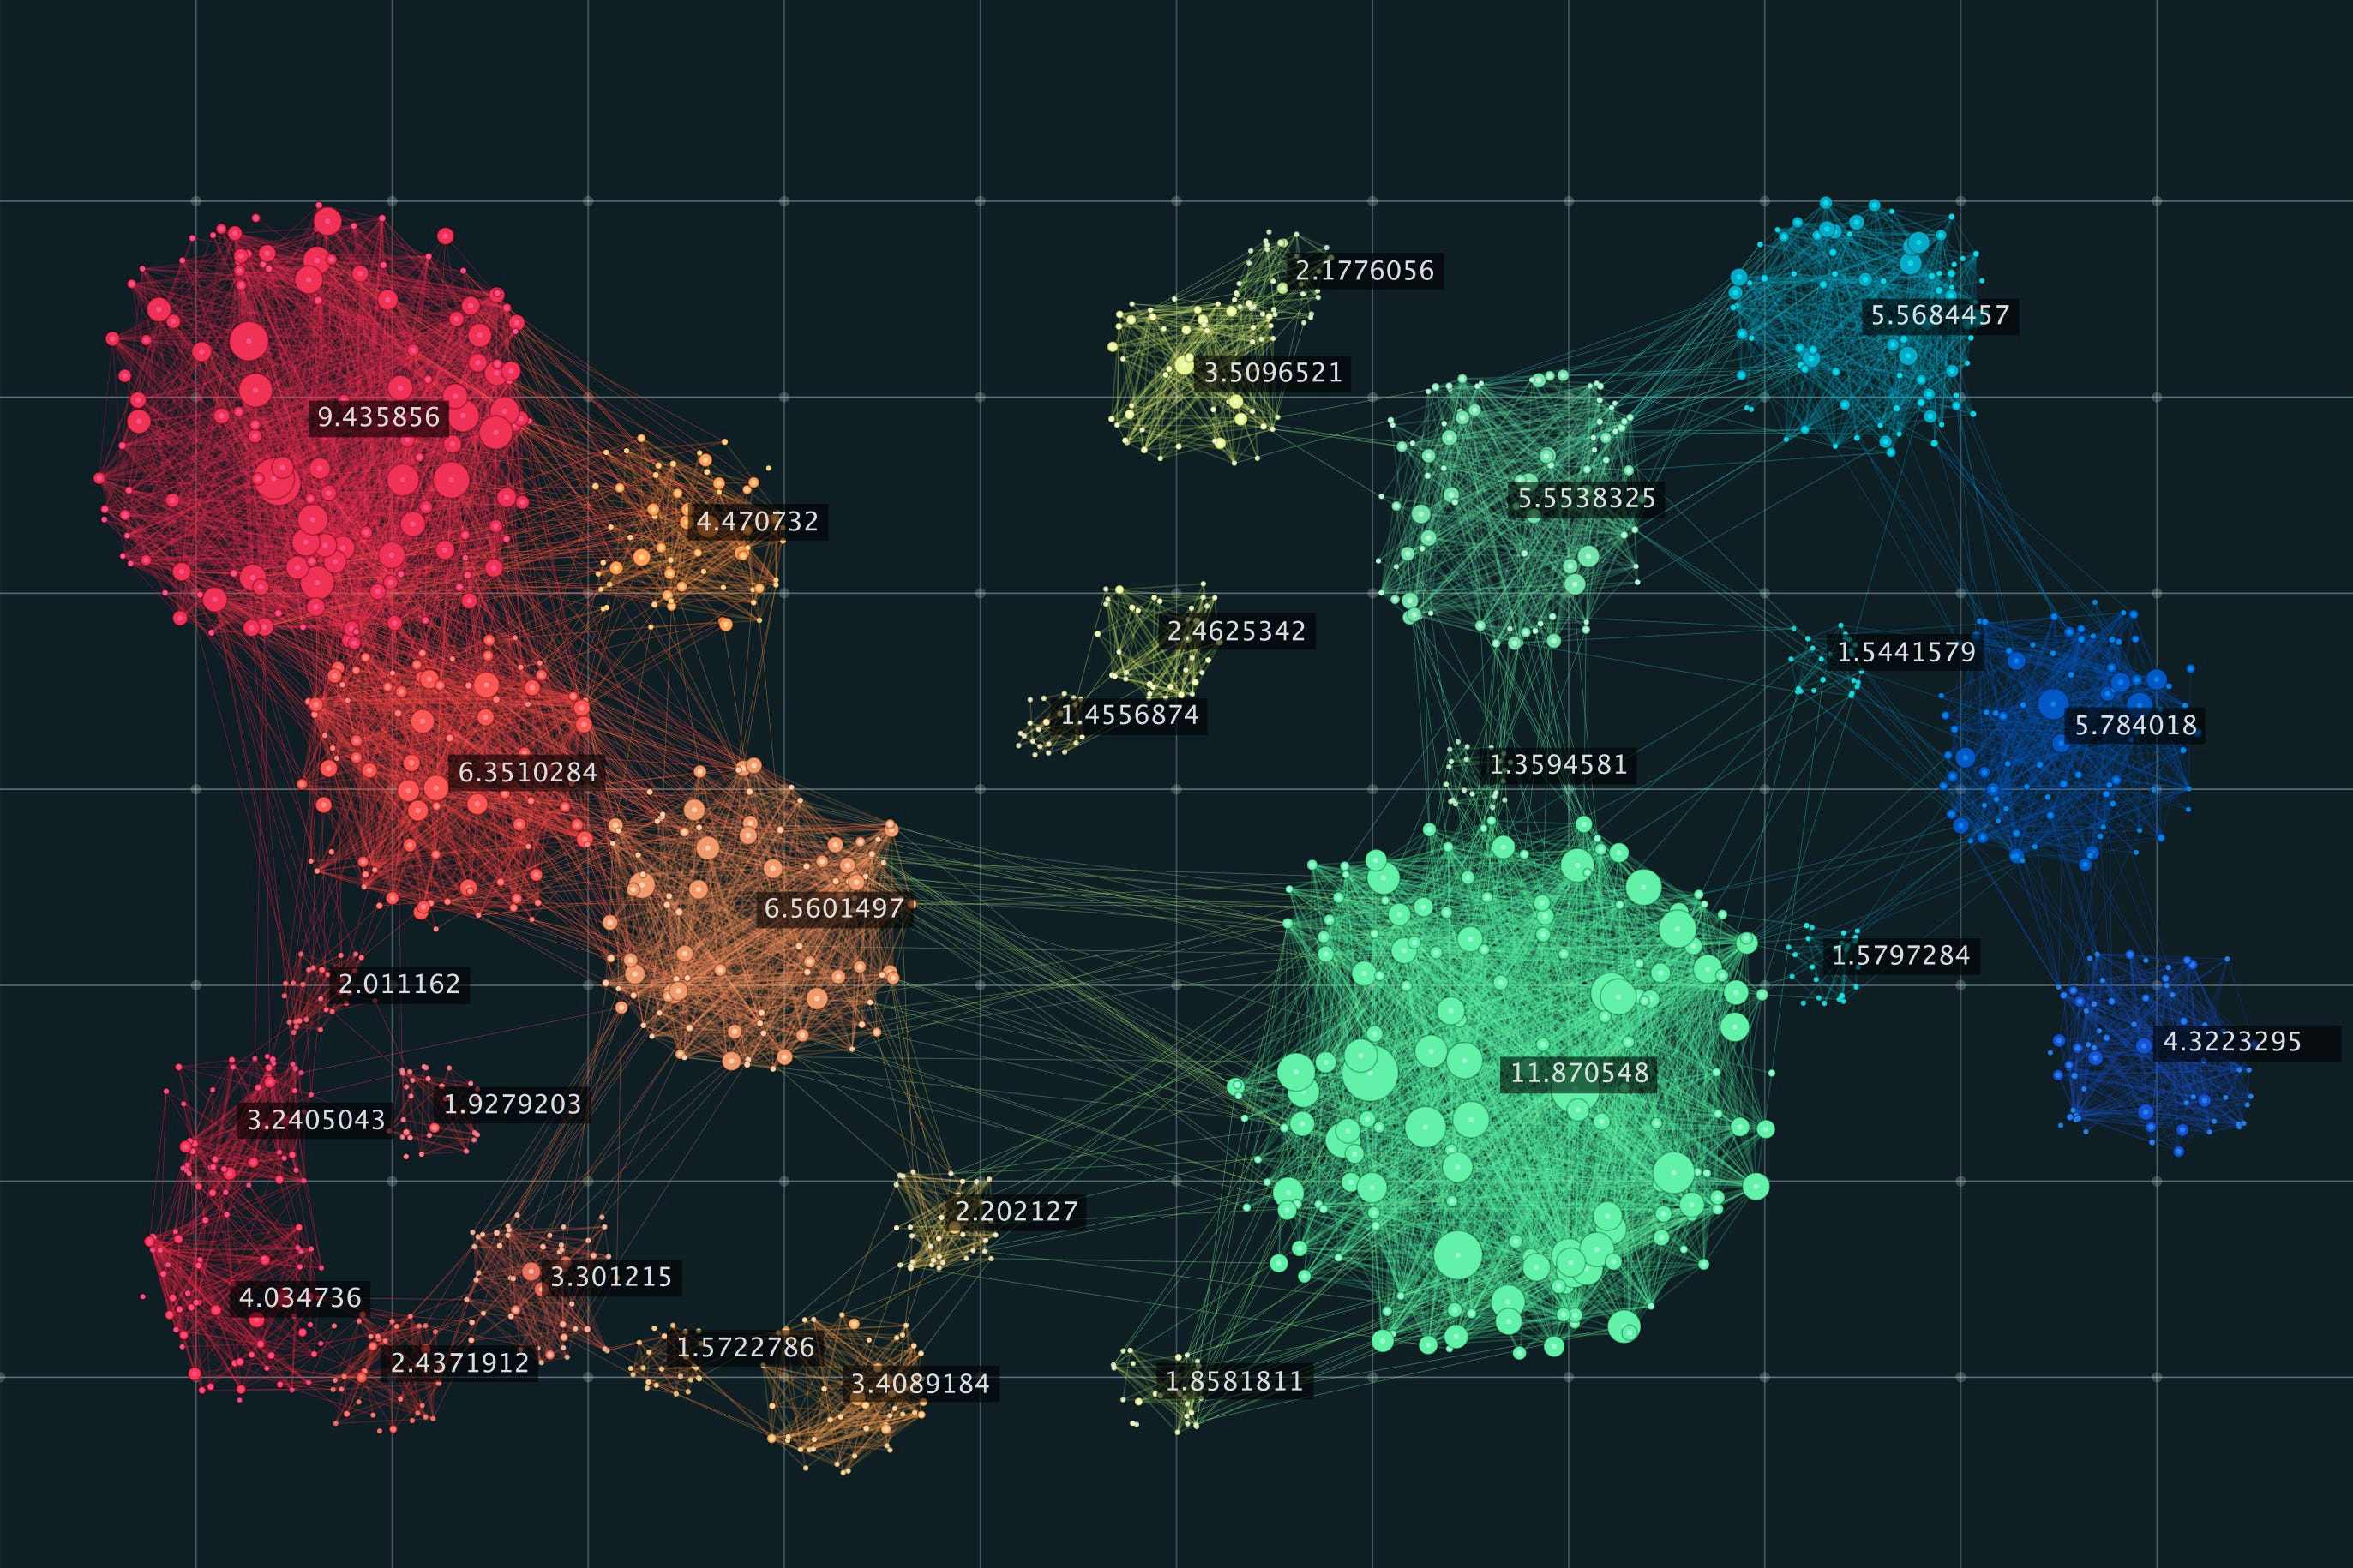
PART 4: CLUSTERING
Clustering is the task of dividing the unlabeled data or data points into different clusters such that similar data points fall in the same cluster than those which differ from the others. In simple words, the aim of the clustering process is to segregate groups with similar traits and assign them into clusters.
Two of the most popular clustering algorithms(Used in this project)–
K Means Clustering :The basic idea behind k-means clustering, is to define clusters such that the total intra-cluster variation [or total within-cluster sum of square (WSS)] is minimized. The total wss measures the compactness of the clustering, and we want it to be as small as possible
Different Methods to Find the Best Value of K:
(a)Elbow Curve Method: The elbow method runs k-means clustering (kmeans number of clusters) on the dataset for a given range of values of k. In the elbow method, we plot mean distance and look for the elbow point where the rate of decrease shifts.

Slide 34
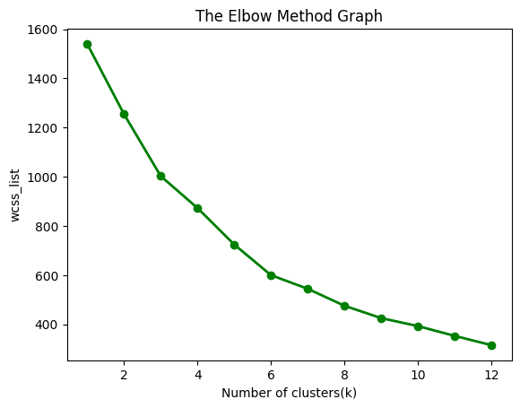
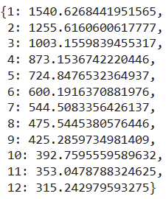
At first we have calculated Within Cluster Sum of Squares (WCSS) for 12 clusters. And got the following results
+6
plot for sum of squared distance for each number of cluster:
WCSS value for 12 Clusters
CONCLUSION:
The point at which the elbow shape is created is 6; that is, our K value or an optimal number of clusters is 6 i.e. after 6th cluster WCSS plot starts looking linear. In other words, the decrease in WCSS is not much after 6th point.

Slide 35
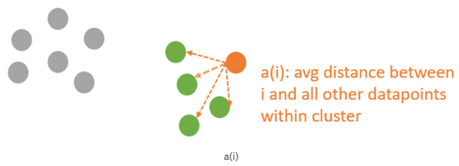
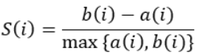
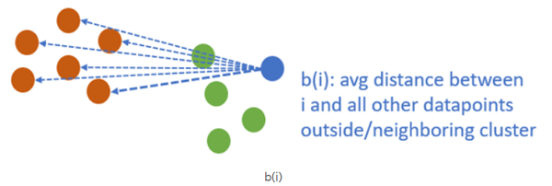
(b) Silhouette Analysis: The silhouette coefficient or silhouette score kmeans is a measure of how similar a data point is within-cluster (cohesion) compared to other clusters (separation).
Formula to calculate Silhouette Score:
Where,
S(i) is the silhouette coefficient of the data point i.
a(i) is the average distance between i and all the other data points in the cluster to which i belongs.
b(i) is the average distance from i to all clusters to which i does not belong.
We will then calculate the average_silhouette for every k.
Then plot the graph between average_silhouette and K.
The value of the silhouette coefﬁcient is between [-1, 1].

Slide 36

Plot a graph between different no. of clusters and Shilhouette Score:
From the above plot we can see for the n_cluster=5 silhouette score is maximum after this there is small increment in silhouette score.

Slide 37


Silhouette Analysis for K-means clustering on sample data for different no. of clusters:
For 2 Clusters
For 3 Clusters

Slide 38


For 4 Clusters
For 5 Clusters

Slide 39

For 6 Clusters
Observations from above Silhouette Plots:
The silhouette plot shows that the n_cluster value of 2 is a bad pick, as all the points in the cluster with cluster_label=0 are below-average silhouette scores.
The silhouette plot shows that the n_cluster value of 3 is a bad pick, as all the points in the cluster with cluster_label= 2 are below-average silhouette scores

Slide 40

The silhouette plot shows that the n_cluster value of 4 is a bad pick, as all the points in the cluster with cluster_label=2 and 3 are below-average silhouette scores.
The silhouette plot shows that the n_cluster value of 6 is a bad pick, as all the points in the cluster with cluster_label=0,2 and 3 and 5 are below-average silhouette scores.
For n_clusters=5all the point in all cluster labels (except 0 and 3) are above average silhouette score and also all the plots are more or less of similar thickness and hence are of similar sizes, as can be considered as best ‘k’.
fitting on 5 clusters:
Visualizing the Clusters:

Slide 41



Clusters on average rating
Clusters with Cost
Clusters on votes

Slide 42

2. Hierarchical Clustering:
In k-means clustering, the number of clusters that you want to divide your data points into, i.e., the value of K has to be pre-determined, whereas in Hierarchical clustering, data is automatically formed into a tree shape form (dendrogram).
Methods of Hierarchical Clustering:
Agglomerative
Divisive.
Implementation
dendrogram to visualize the clusters
dendrogram to visualize the clusters
This dendrogram is created using agglomerative approach in which initially, each object is considered to be its own cluster. According to a particular procedure, the clusters are then merged step by step until a single cluster remains. At the end of the cluster merging process, a cluster containing all the elements will be formed.

Slide 43


Calculating Silhouette score for different no. of clusters using hyperparameter tuning:
Visualize the Clusters:
Silhouette score is maximum for n_clusters=2 hence optimal k for hierarchical clustering is 2.

Slide 44
Conclusion:
For Sentiment Analysis on Reviews Random Forest gives the best results followed by XG boost and decision tree.
For K-Means Clustering optimal no. of clusters:
By Elbow Method=6
By Silhouette Score=5
For Hierarchical Clustering optimal no. of clusters=2

Slide 45


